Slide 1
Investment Decision Recommendation System Presentation
Varsha S
Data Science
PSG College Of Technology

Slide 2
INTRODUCTION
- Objective: Building a recommendation system for best investment decisions
- Importance: Assists users in making the best investment choices.

Slide 3
PROBLEM STATEMENT
- Dataset: Contains information on individuals and investment behavior.
- Task: Build a recommendation system based on various factors.
- Goal: Predict the best investment decision for new data.

Slide 4
Methodology Overview
- Data Preprocessing: Handle missing values, clean data, and feature engineering.
- Model Selection: Train baseline models, evaluate, and optimize.
- Evaluation: Use metrics like accuracy, precision, recall, and F1-score.
- Visualization: Explore data insights and user-friendly interface.
- Power BI Integration: Advanced analysis and interactive dashboards.

Slide 5
Data Preprocessing
- Data Loading: Load dataset and identify missing values.
- Data Cleaning: Remove duplicates, correct data types, and ensure consistency.
- Encoding: Encode categorical variables using label or one-hot encoding.

Slide 6
Visualization and User Interface
- Visualizations: Explore demographic distribution, employment details, and investment behavior insights.
- User Interface: Streamlit-based interface for user-friendly data exploration and predictions.

Slide 7
Model Selection
- Baseline Models: Train Decision Trees, Random Forests for benchmarking.
- Evaluation Metrics: Use accuracy, precision, recall, F1-score for evaluation.
- Hyperparameter Tuning: Optimize models using grid/random search.
- Final Model: Select the best-performing model (e.g., Random Forest Classifier).

Slide 8
Evaluation
- Cross-Validation: Validate model performance with K-fold cross-validation.
- Model Comparison: Compare models based on evaluation metrics.
- Results: Present accuracy, precision, recall, F1-score of the recommendation system.

Slide 9
Power BI Integration
- Dashboards: Integrate Power BI for advanced analysis and interactive dashboards.
- Insights: Analyze gender distribution, city distribution, return earned, knowledge about investment, and household income.

Slide 10
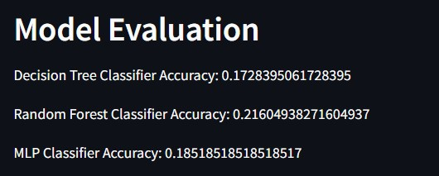
Recommendations and Insights
- Insights: Factors influencing investment decisions, suggestions for improvement.
Advanced Data Preprocessing
Performance Optimization
Feedback Mechanism
Model Enhancement

Slide 11
Conclusion
The Investment Decision Recommendation System leverages data preprocessing, model selection, evaluation, visualization, user interface, and Power BI analysis to assist users in making better investment decisions.
The systematic approach ensures reliability, accuracy, and user-friendliness throughout the system

Slide 12
THANK YOU

